Slide 1

Creating Components in React
Presented by
R Veena Madhuri
22H51A0552
CSE D

Slide 2

INTRODUCTION
React Components are the building block of React Application. They are the reusable code blocks containing logics and and UI elements. They have the same purpose as JavaScript functions and return HTML. Components make the task of building UI much easier.
A UI is broken down into multiple individual pieces called components. You can work on components independently and then merge them all into a parent component which will be your final UI.
Components promote efficiency and scalability in web development by allowing developers to compose, combine, and customize them as needed.

Slide 3
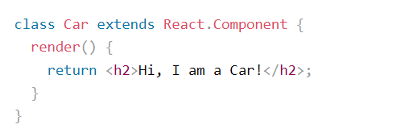
Create Your First Component
Class Component
A class component must include the extends React Component statement. This statement creates an inheritance to React. Component, and gives your component access to React. Component's functions.
The component also requires a render() method, this method returns HTML.
Example

Slide 4
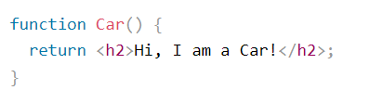
Function Component:
A Function component also returns HTML, and behaves much the same way as a Class component, but Function components can be written using much less code, are easier to understand, and will be preferred in this tutorial.
Example

Slide 5
Functional vs. Class Components
Functional Components
Simpler and more efficient. Defined using JavaScript functions.
Easier to write and read.
Suitable for stateless components.
Class Components
More complex and allow for more advanced features. Defined as JavaScript classes.
Support state management and lifecycle methods.
Useful for components with complex logic and interactions

Slide 6
Anatomy of a React Component
JSX Syntax
Components are written using JSX, a syntax extension that allows embedding HTML-like elements within JavaScript.
Props
Data passed from parent components to child components.
State
Internal data managed by the component.
Render Method
Returns the JSX structure that will be displayed on the screen.

Slide 7
Passing Data to Components
Props
Props are used to pass data from parent components to child components. They are immutable, meaning they cannot be changed directly by the child component.
2. Data Flow
Data flows in a single direction, from parent to child. This ensures a clear and predictable flow of information.
3. Passing Data
Parent components pass data to child components through props by using attribute-like syntax within JSX.

Slide 8
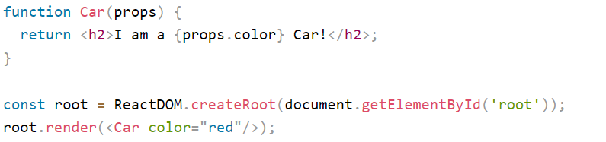
Props
Components can be passed as props, which stands for properties.
Props are like function arguments, and you send them into the component as attributes.
Example:
Use an attribute to pass a color to the Car component, and use it in the render() function:

Slide 9
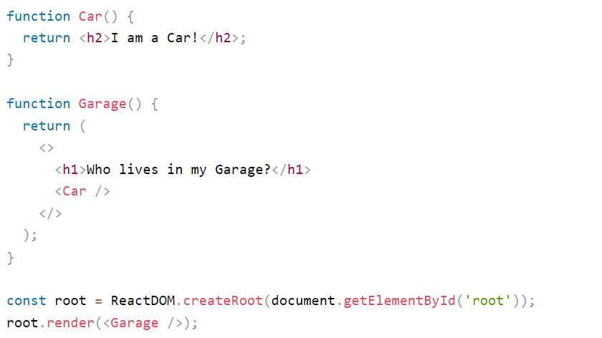
Components in Components
We can refer to components inside other components:
Example
Use the Car component inside the Garage component:

Slide 10
THANK YOU

